Slide 1
A Physics Model for a Backflip
Joshua Berg

Slide 2
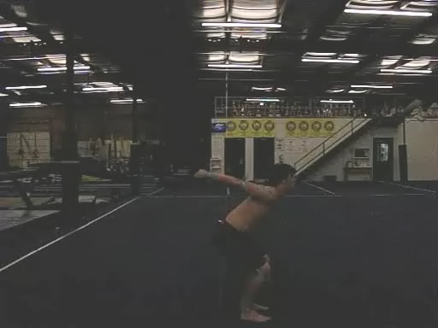
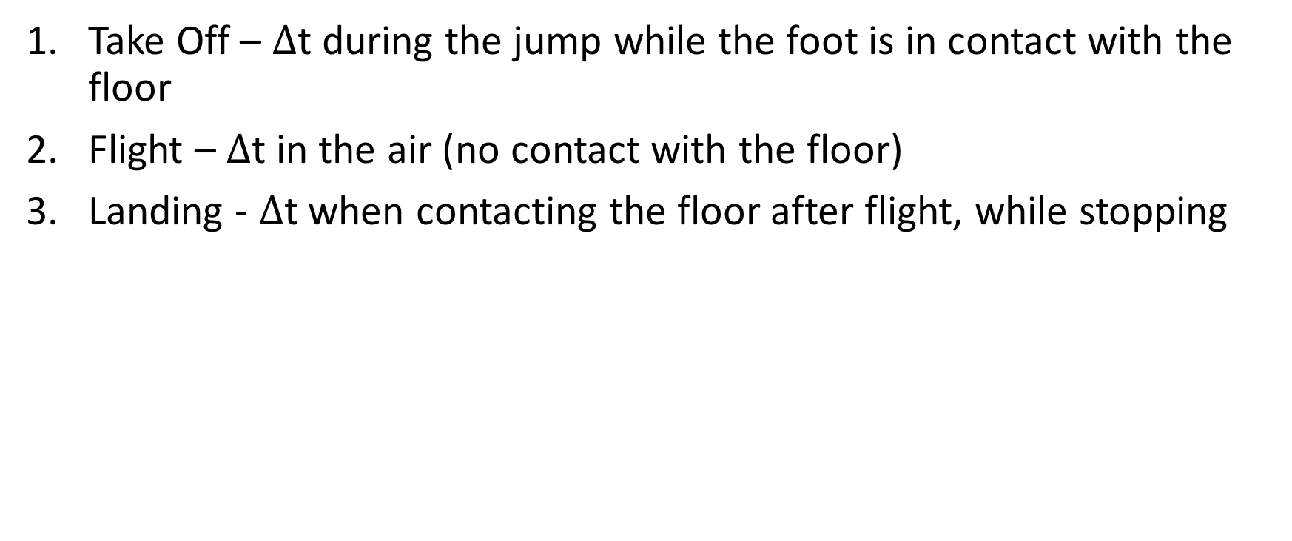
3 Parts of the Motion During a Backflip
Take Off – $∆$t during the jump while the foot is in contact with the floor
Flight – $∆$t in the air (no contact with the floor)
Landing - $∆$t when contacting the floor after flight, while stopping

Slide 3
Center of Mass Motion
Apply the Momentum Principle and Angular Momentum Principle during 5 distinct instances of interest
Initial Equilibrium
When leaving the floor
While in the air
When first landing
Final Equilibrium

Slide 4
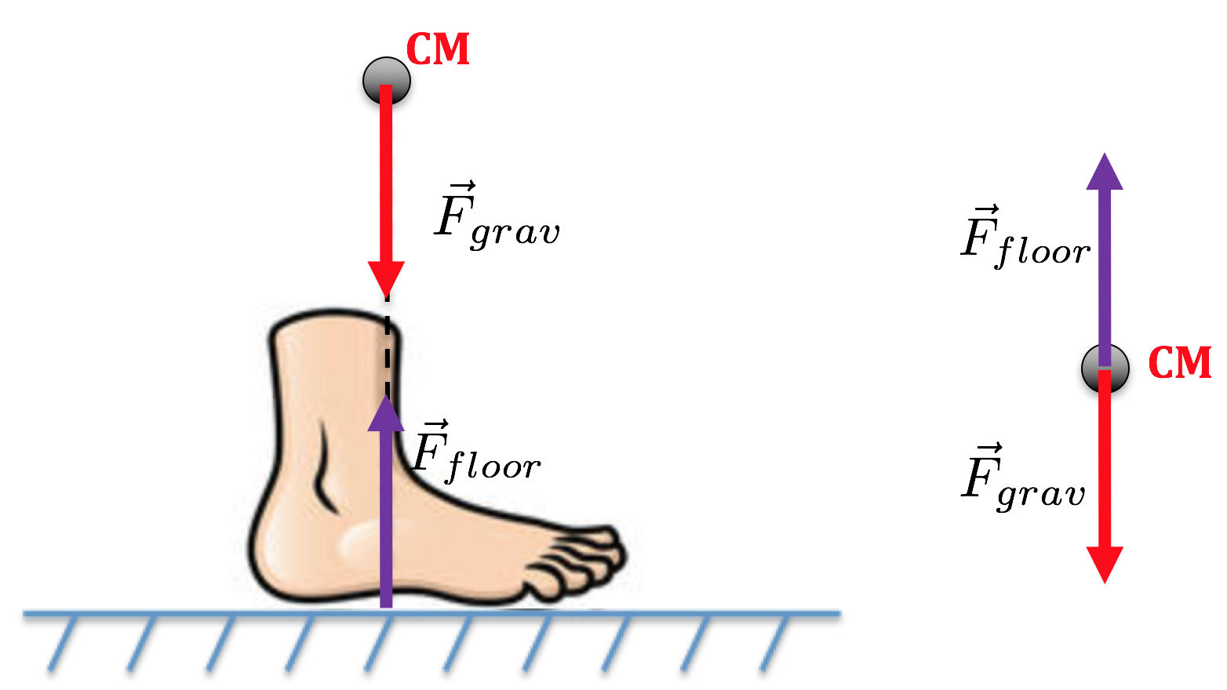
Center of Mass Motion - Equilibrium

Slide 5
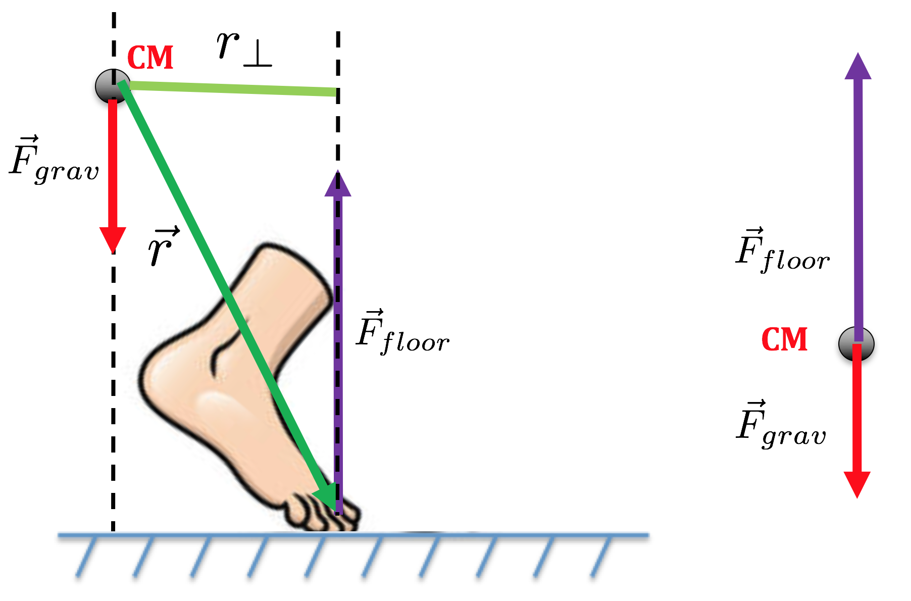
Center of Mass Motion– Take Off

Slide 6
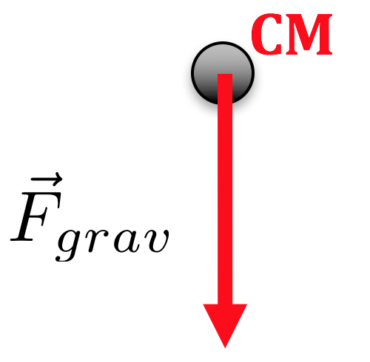
Center of Mass Motion – Flight

Slide 7
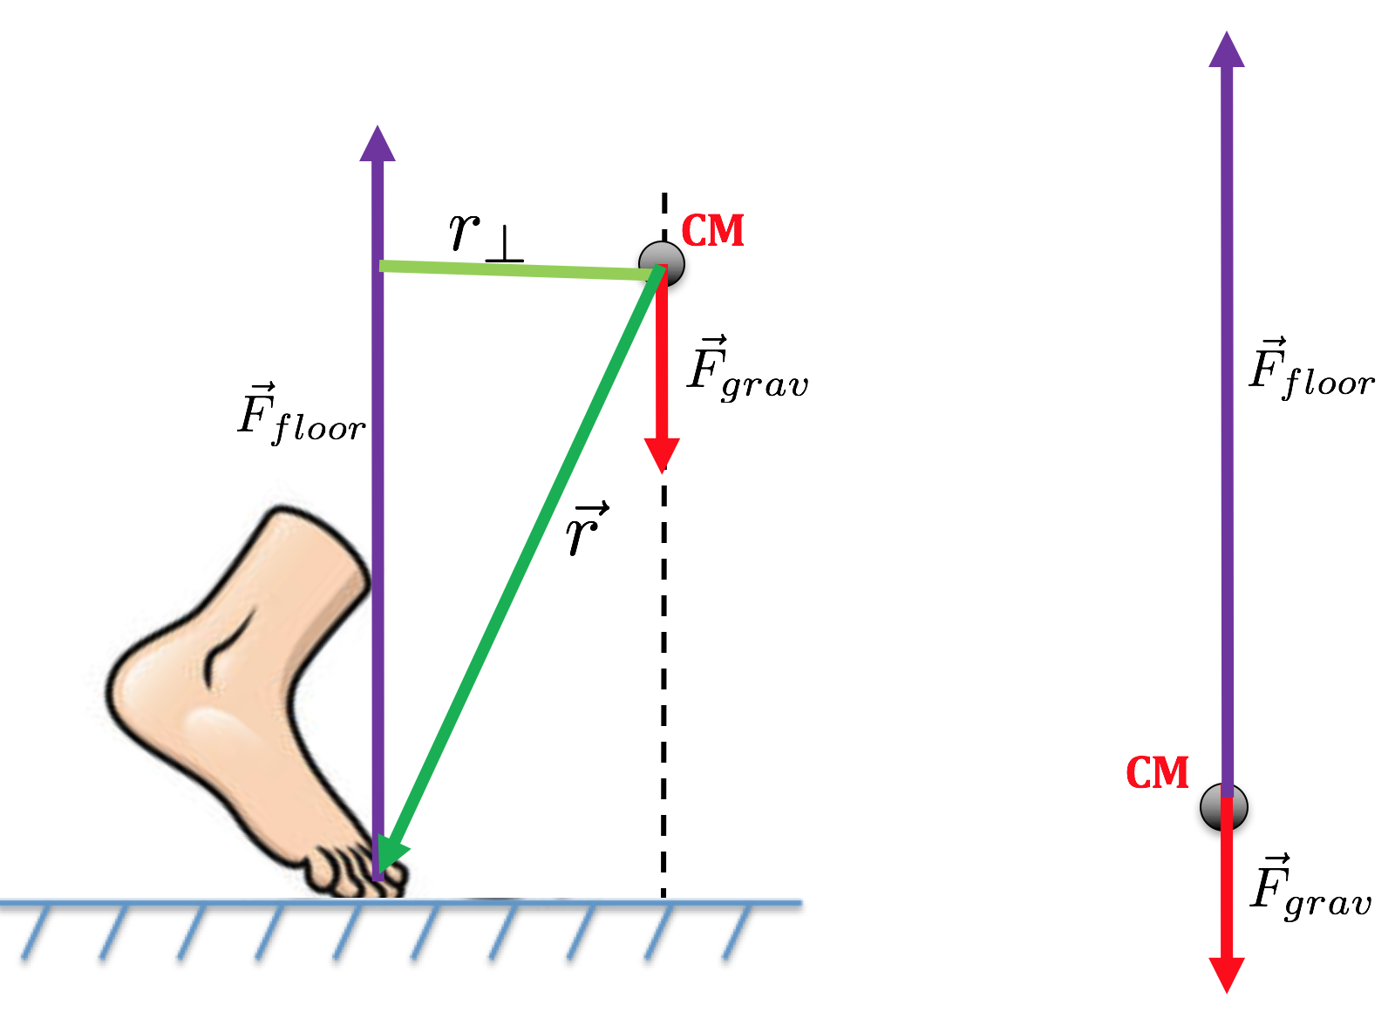
Center of Mass Motion – Landing

Slide 8
Center of Mass Motion - Equilibrium

Slide 9
Reason take step forward or backward

Slide 10
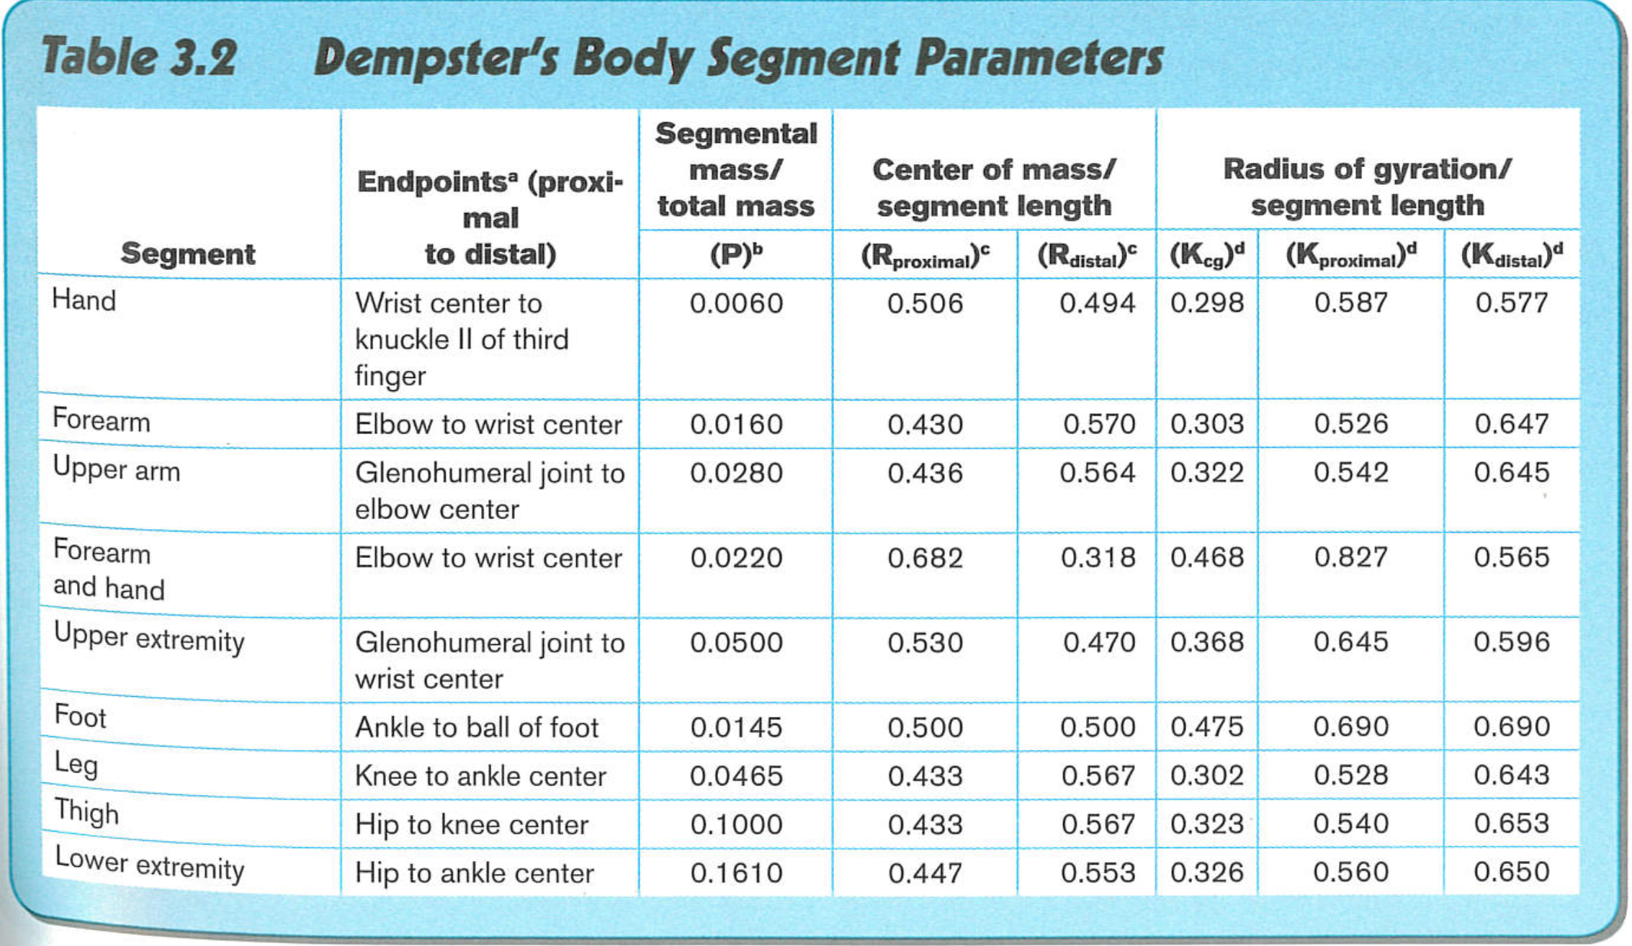
Dempster’s Body Segment Paramaters

Slide 11
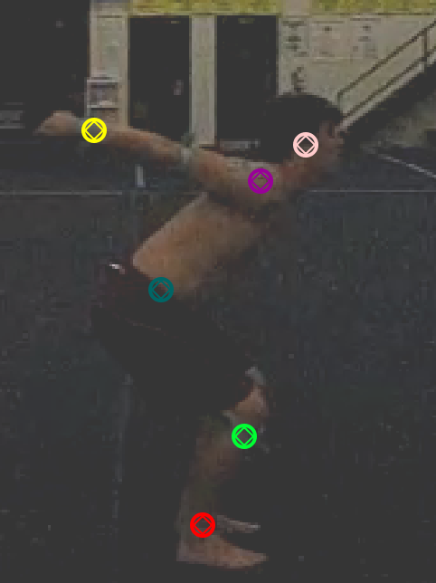
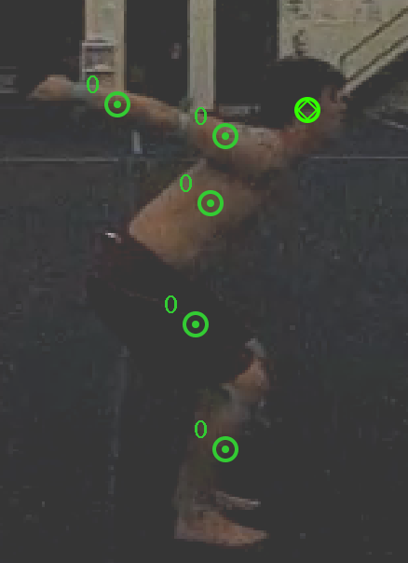
Tracker Application of Dempster’s

Slide 12
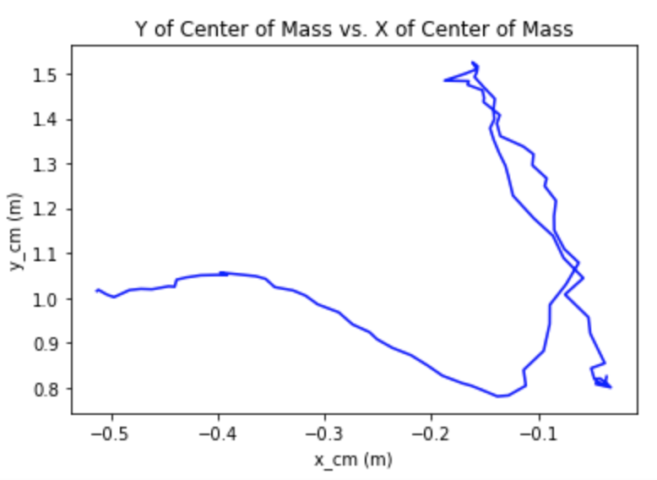
of Center of Mass

Slide 13
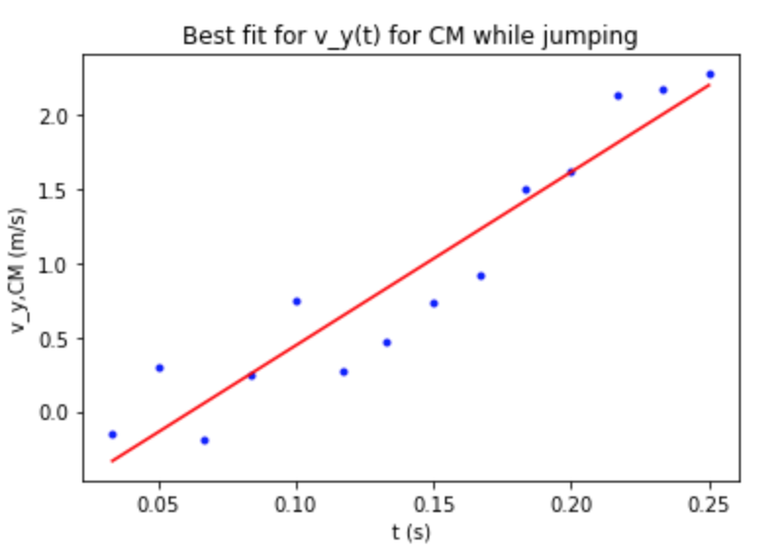
of Center of Mass During Take Off
N

Slide 14
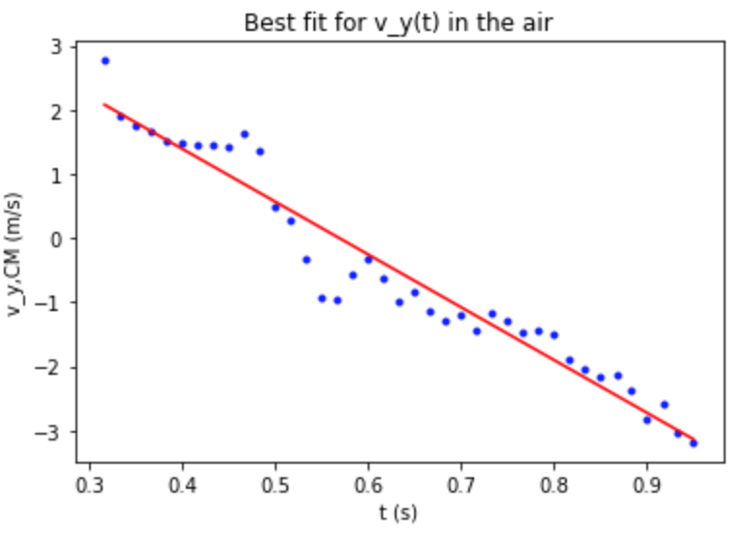
of Center of Mass During Flight
N/kg

Slide 15
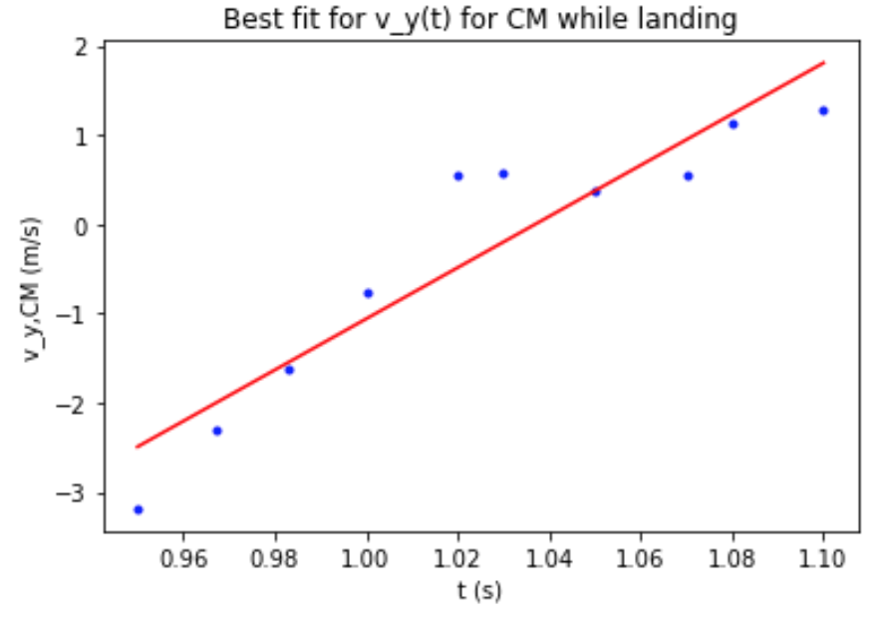
of the Center of Mass During Landing
N

Slide 16
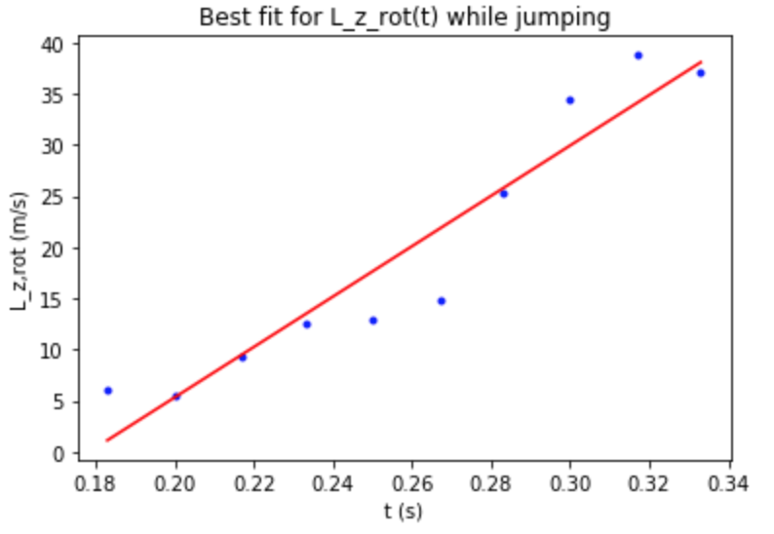
During Take Off
N⋅m

Slide 17
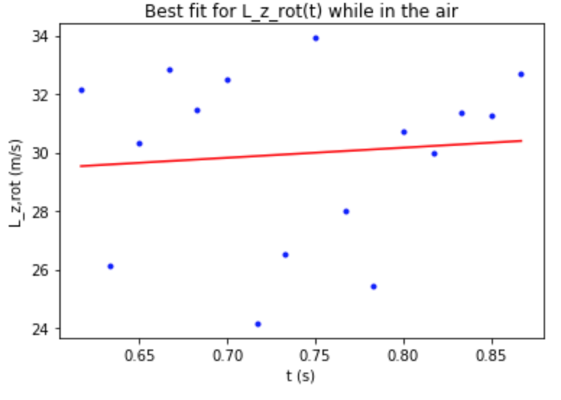
During Flight
N⋅m

Slide 18
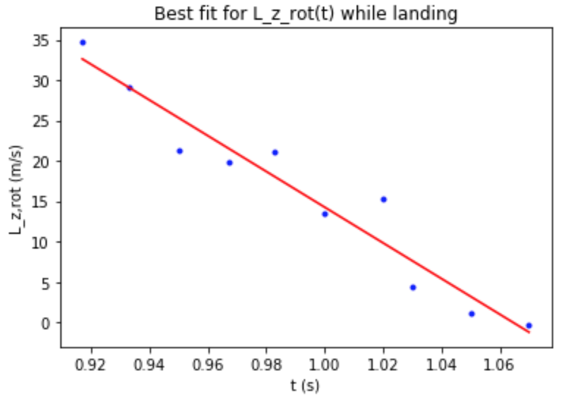
During Landing
N⋅m

Slide 19
What was learned?
Uncertainty
Tracker Analysis of Motion
Prediction of Back Flip Motion
Different Landings
Force on Landing

Slide 20
Acknowledgments
Research Participant
Jon Hatchell
Department of Physics, High Point University
Dr. Aaron Titus

Slide 21
References
Robertson, Gordon, Graham Caldwell, Joseph Hamill, Gary Kamen, and Saunders Whittlesey. Research Methods in Biomechanics . N.p.: Human Kinetics , 2004. Print.

Slide 22
Questions?

